Slide 1

DESIGN AND ANALYSIS OF ALGORITHMS
Dr. Kashif Ayyub

Slide 2
Loop Invariant
A loop invariant is a relation among program variables that is true when control enters a loop, remains true each time the program executes the body of the loop, and is still true when control exits the loop.
Understanding loop invariants can help us analyze programs, check for errors, and derive programs from specifications.
Formally:
Initialization: It is true prior to the first iteration of the loop.
Maintenance: If it is true before an iteration of the loop, it remains true before the next iteration.
Termination: The loop terminates, and when it terminates, the invariant usually along with the reason that the loop terminated gives us a useful property that helps show that the algorithm is correct.

Slide 3
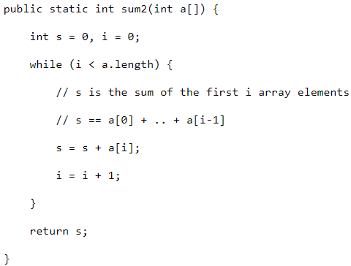
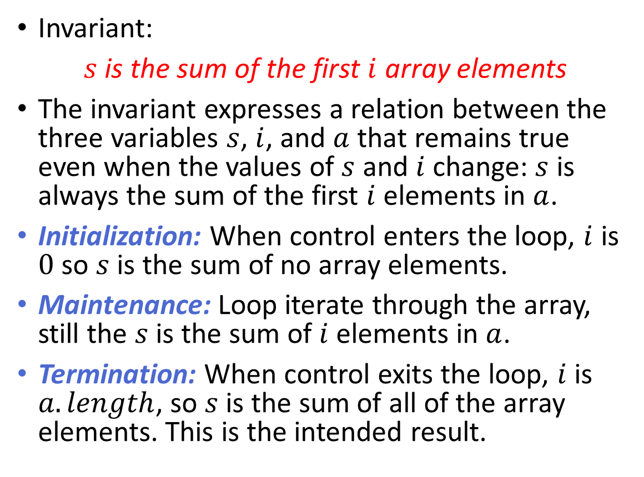
Loop Invariant - Example
Invariant:
$s$ is the sum of the first $i$ array elements
The invariant expresses a relation between the three variables $s$, $i$, and $a$ that remains true even when the values of $s$ and $i$ change: $s$ is always the sum of the first $i$ elements in $a$.
Initialization: When control enters the loop, $i$ is $0$ so $s$ is the sum of no array elements.
Maintenance: Loop iterate through the array, still the $s$ is the sum of $i$ elements in $a$.
Termination: When control exits the loop, $i$ is $a.length$, so $s$ is the sum of all of the array elements. This is the intended result.

Slide 4
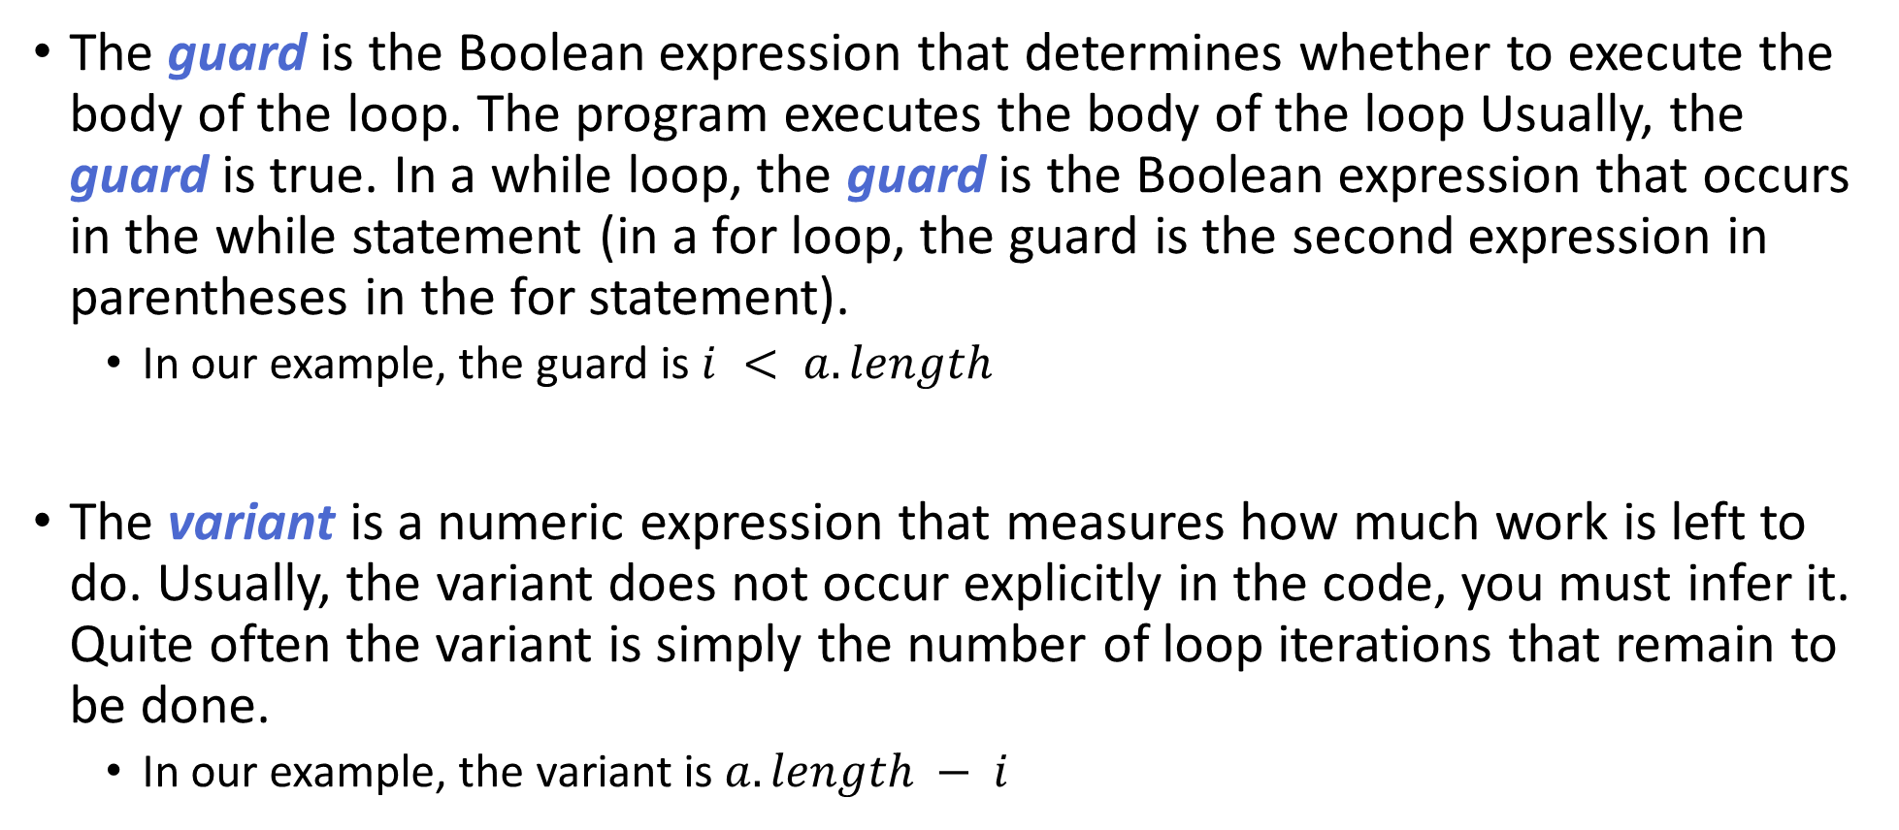
Some Definitions
The guard is the Boolean expression that determines whether to execute the body of the loop. The program executes the body of the loop Usually, the guard is true. In a while loop, the guard is the Boolean expression that occurs in the while statement (in a for loop, the guard is the second expression in parentheses in the for statement).
In our example, the guard is $i < a.length$
The variant is a numeric expression that measures how much work is left to do. Usually, the variant does not occur explicitly in the code, you must infer it. Quite often the variant is simply the number of loop iterations that remain to be done.
In our example, the variant is $a.length − i$

Slide 5

Correctness of a Loop
A loop is correct if the five conditions in this checklist are all true:
Initialization: the invariant is true before entering the loop
Invariance: the body of the loop preserves the invariant
Progress: the body of the loop decreases the variant.
Boundedness: when the value of the variant falls below some threshold, the guard becomes false.
Exit: the negation of the guard and the invariant describe the goal.

Slide 6
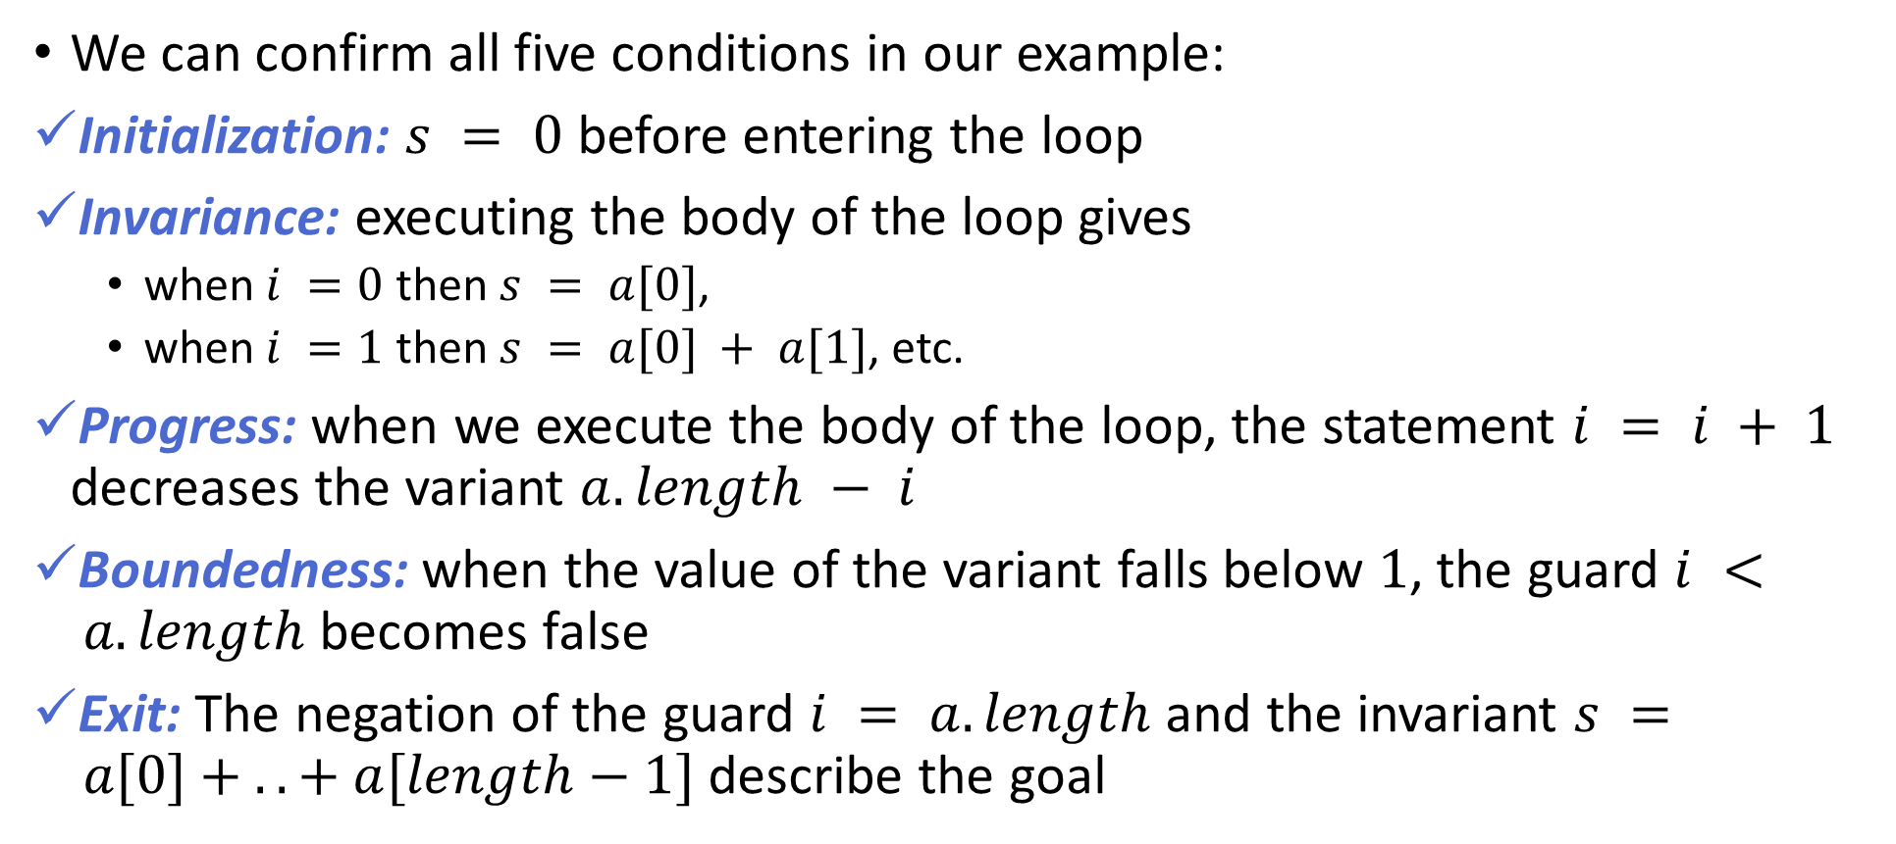
Correctness of a Loop
We can confirm all five conditions in our example:
Initialization: $s = 0$ before entering the loop
Invariance: executing the body of the loop gives
when $i =0$ then $s = a[0]$,
when $i =1$ then $s = a[0] + a[1]$, etc.
Progress: when we execute the body of the loop, the statement $i = i + 1$ decreases the variant $a.length − i$
Boundedness: when the value of the variant falls below $1$, the guard $i < a.length$ becomes false
Exit: The negation of the guard $i = a.length$and the invariant $s = a[0] + .. + a[length−1]$ describe the goal

Slide 7
Purpose of Loop Invariant
Loop invariants capture key facts that explain why code works.
This means that if you write code in which the loop invariant is not obvious, you should add a comment that gives the loop invariant.
This helps other programmers understand the code and helps keep them from accidentally breaking the invariant with future changes.
Loop invariants are used to reason about the correctness of computer programs. Intuition or trial and error can be used to write easy algorithms however when the complexity of the problem increases, it is better to use formal methods such as loop invariants.
Loop invariants can be used to prove the correctness of an algorithm, debug an existing algorithm without even tracing the code or develop an algorithm directly from specification.

Slide 8
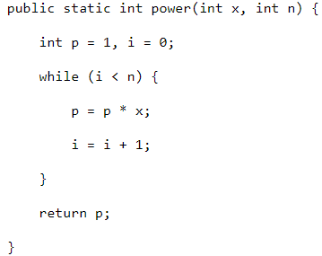
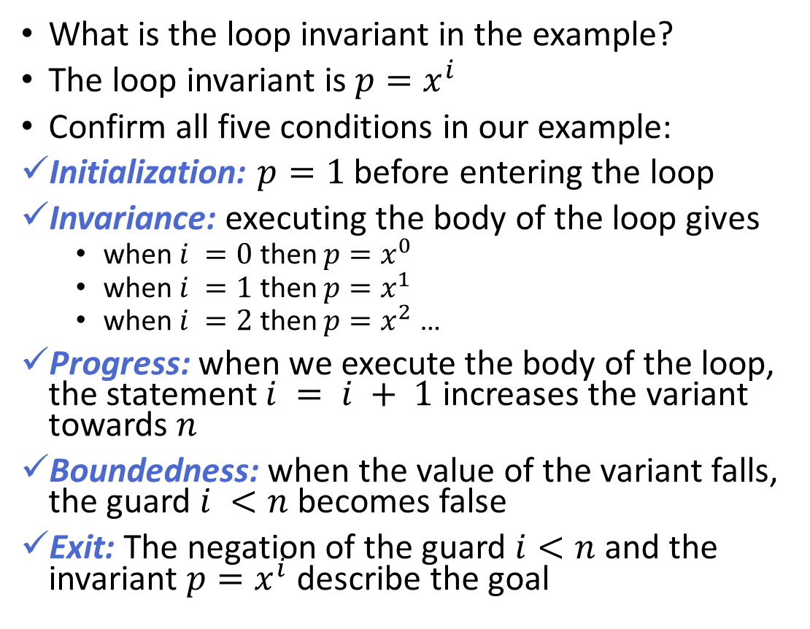
Loop Invariant – Example 2 (Your Task)
What is the loop invariant in the example?
The loop invariant is ${p=x}^{i}$
Confirm all five conditions in our example:
Initialization: $p=1$ before entering the loop
Invariance: executing the body of the loop gives
when $i =0$ then $p=x^{0}$
when $i =1$ then $p=x^{1}$
when $i =2$ then $p=x^{2}$ …
Progress: when we execute the body of the loop, the statement $i = i + 1$ increases the variant towards $n$
Boundedness: when the value of the variant falls, the guard $i <n$ becomes false
Exit: The negation of the guard $i<n$and the invariant $p=x^{i}$ describe the goal

